Slide 1
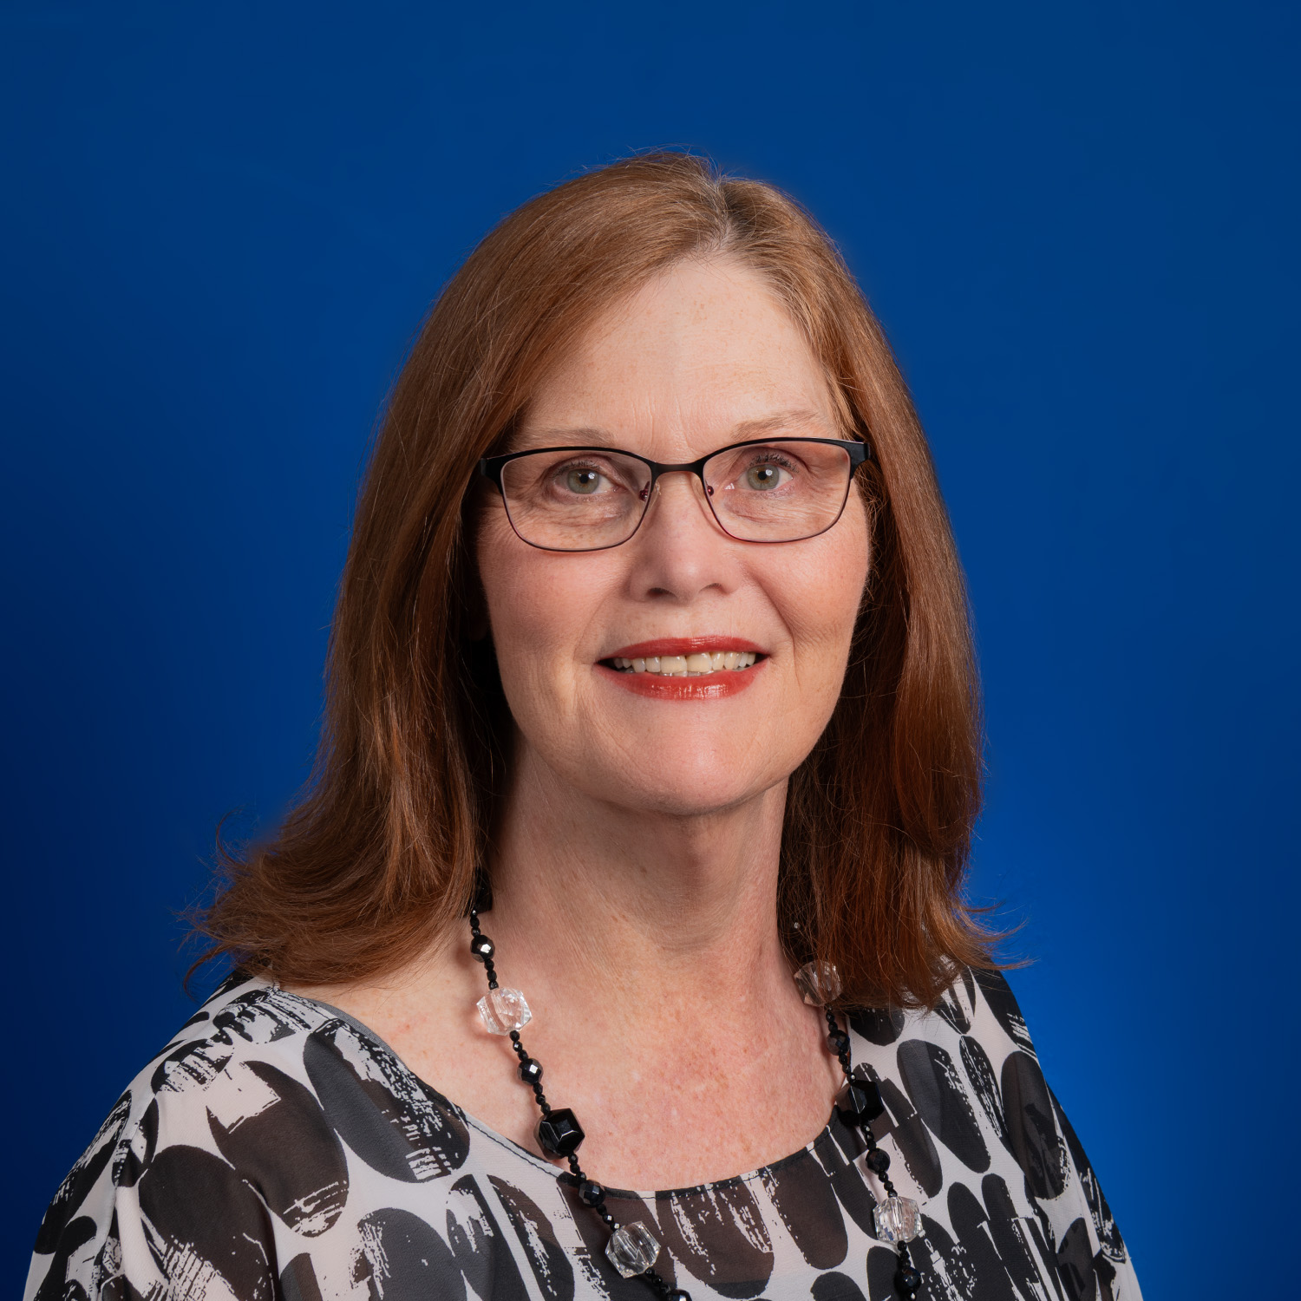
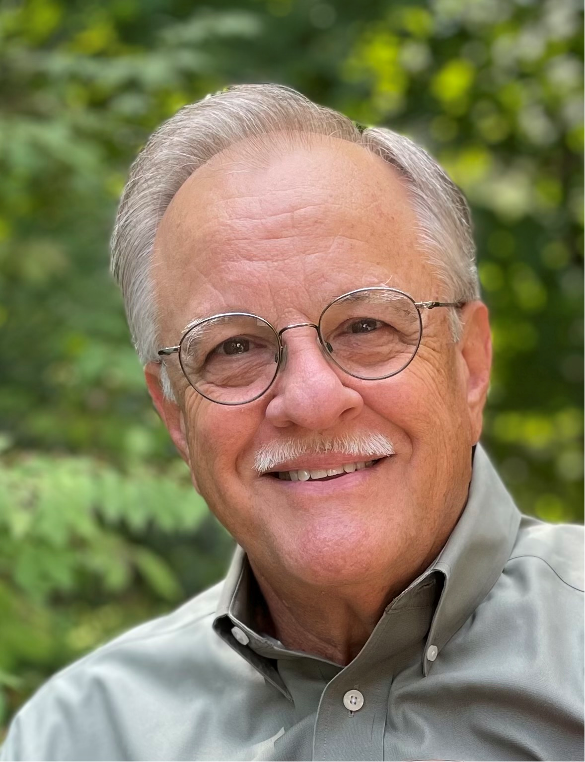
50 Years of Ministry: Honoring the Past, Shaping the Future
Steve Smith, Arkansas
Vicki Spurgeon, Oklahoma

Slide 2
Prayer and Devotion
Write this. Write what you see. Write it out in big block letters so that it can be read on the run. This vision-message is a witness pointing to what’s coming. It aches for the coming---it can hardly wait! And it doesn’t lie. If it seems slow in coming, wait. It’s on its way. It will come right on time.
Habakkuk 2:2-3
The Message

Slide 3
The Foundations that Define Kairos Prison Ministry, International, Inc.
Mission
Vision
Core Values
Statement of Faith
Habakkuk 2:2-3, Proverbs 29:18

Slide 4
Our Mission
The mission of Kairos Prison Ministry is to share the transforming love and forgiveness of Jesus Christ to impact the hearts and lives of incarcerated men, women and youth, as well as their families, to become loving and productive citizens of their communities.

Slide 5
Our Vision
A community spiritually freed from the effects of imprisonment reaching all impacted by incarceration, through the love, hope and faith found in Jesus Christ.

Slide 6
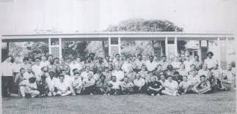
In the Beginning…
The first weekend was held in the fall of 1976, led by Tom Johnson, where “Cursillo in Prison” was held in the Union Correctional Institution at Raiford, Florida.

Slide 7
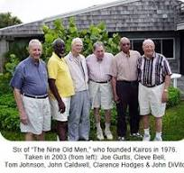
In the Beginning…
In 1979 the beloved “Nine Old Men”, led by Tom Johnson, worked and came together to adopt the name “Kairos” and launched the ministry that has continued to grow.

Slide 8
Over the Years
First official Kairos weekend in a women’s prison was held in 1982.
First Kairos Outside was held in April of 1990.
First Kairos Torch program launched in September of 1997 to include the youth, age 25 and younger.
Founding documents written
Developed first program manual
Kairos weekends then began in 1979

Slide 9
Lessons Learned Through the Years
Always keep your focus on Christ.
Maintain financial health and integrity of the ministry.
John 15: 1-2

Slide 10
Lessons Learned Through the Years
Continuously grow and develop the volunteer base through recruitment and training.
Continuing Ministry is where lasting change can take place.

Slide 11
Lessons Learned Through the Years
We are better together.
Change will occur in Technology, Corrections Systems and Culture

Slide 12
Faithfully Moving Forward
History Can Inspire Us Onward
  Program expansion and growth.
  Other countries impacted.
  3. People impacted.

Slide 13
Faithfully Moving Forward
Remembering the work of God reminds us of His faithfulness.
Lean into the vision and move forward into God’s promise of the future.
Philippians 3:13

Slide 14
Faithfully Moving Forward
We are called to be a faithful body to take the message out to all the world.
Acts: 1:8

Slide 15
Faithfully Moving Forward
Strength is found in community.
We are called to discipleship.
1. It is profoundly relational.
2. Each consider the journey you have already taken in Kairos.
3. Think upon the celebrations you have already witnessed.
Ephesians 4:1-3

Slide 16
“Is He Worthy”
(Please join us in song, originally sung by Andrew Peterson)
Do you feel the world is broken? WE DO
Do you feel the shadow deepen? WE DO
But do you know that all the dark won’t stop the light
from getting through? WE DO
Do you wish that you could see it all made new? WE DO
“Is He Worthy,” by Andrew Peterson, Ben Shive © 2018 Capitol CMG Genesis, Junkbox Music, Vamos Publishing, Jakedog Music. Used by Permission. CCLI License # 23171467

Slide 17
Is all creation groaning? IT IS
Is a new creation coming? IT IS
Is the Glory of the Lord to be the light
within our midst? IT IS
Is it good that we remind ourselves of this? IT IS
“Is He Worthy,” by Andrew Peterson, Ben Shive © 2018 Capitol CMG Genesis, Junkbox Music, Vamos Publishing, Jakedog Music. Used by Permission. CCLI License # 23171467

Slide 18
Is anyone worthy? Is anyone whole?
Is anyone able to break the seal and open the scroll?
The Lion of Judah who conquered the grave
He is David’s root and the Lamb who died to ransom the slave.
Is He worthy? Is He worthy?
Of all blessing and honor and glory
Is He worthy of this? HE IS
“Is He Worthy,” by Andrew Peterson, Ben Shive © 2018 Capitol CMG Genesis, Junkbox Music, Vamos Publishing, Jakedog Music. Used by Permission. CCLI License # 23171467

Slide 19
Does the Father truly love us? HE DOES
Does the Spirit move among us? HE DOES
And does Jesus, our Messiah hold
forever those he loves? HE DOES
Does our God intend to dwell again with us? HE DOES
“Is He Worthy,” by Andrew Peterson, Ben Shive © 2018 Capitol CMG Genesis, Junkbox Music, Vamos Publishing, Jakedog Music. Used by Permission. CCLI License # 23171467

Slide 20
Is anyone worthy? Is anyone whole?
Is anyone worthy to break the seal and open the scroll?
The Lion of Judah of Judah, who conquered the grave
He is David’s root and the Lamb who died to ransom the slave.
“Is He Worthy,” by Andrew Peterson, Ben Shive © 2018 Capitol CMG Genesis, Junkbox Music, Vamos Publishing, Jakedog Music. Used by Permission. CCLI License # 23171467

Slide 21
From every people and tribe, every nation and tongue
He has made us a Kingdom and priests to God
To reign with the Son
Is He worthy? Is He worthy?
Of all blessing and honor and glory
Is He worthy of this? HE IS
“Is He Worthy,” by Andrew Peterson, Ben Shive © 2018 Capitol CMG Genesis, Junkbox Music, Vamos Publishing, Jakedog Music. Used by Permission. CCLI License # 23171467

Slide 22
Is He worthy? Is He worthy?
Of all blessing and honor and glory
Is He worthy of this? HE IS
Is He worthy? Is He worthy? HE IS
HE IS
“Is He Worthy,” by Andrew Peterson, Ben Shive © 2018 Capitol CMG Genesis, Junkbox Music, Vamos Publishing, Jakedog Music. Used by Permission. CCLI License # 23171467

Slide 23
Questions and Comments?
Our Prayer for Kairos Prison Ministry International
Have a blessed Journey ahead!

